Slide 1

Instagram User Analytics
Project 2

Slide 2
Project Overview
This project focuses on analyzing user interactions and engagement with the Instagram app to derive insights that will inform strategic decisions for its future development.
The purpose is to utilize SQL and MySQL Workbench to extract meaningful insights from the user data, ultimately aiming to enhance user experience and drive growth for the platform.

Slide 3
Approach
The approach to get the insights from provided data would involve –
Data Exploration
Data extraction
User Engagement Analysis
Story telling

Slide 4
Tech-Stack Used
SQL
MySQL Workbench 8.0 CE
MS PowerPoint
MySQL workbench provides a GUI for database query which makes the data analysis process efficient. Moreover, It is free and open source, makes it a best option to use it in this project.
Microsoft PowerPoint is a versatile tool to create reports that look good and are easy to understand. Its structured format organizes information, while customization options ensure a professional appearance.

Slide 5

Project Insights
A) Marketing Analysis:
Loyal Users: The 5 users who have been using the platform for the longest time
Id | Username
80 | Darby_Herzog
67 | Emilio_Bernier52
63 | Elenor88
95 | Nicole71
38 | Jordyn.Jacobson2
Query:

Slide 6


Project Insights
A) Marketing Analysis:
2. Inactive User Engagement: Users who have never
posted a single photo on Instagram
Inactive Users Data
Query:

Slide 7
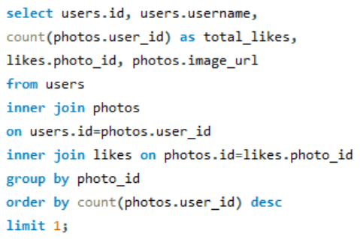
Project Insights
A) Marketing Analysis:
3. Contest Winner: The user with the most likes on a single photo
Query:
ID | username | Photo_id | Total_likes | Image_url
52 | Zack_Kemmer93 | 145 | 48 | https://jarret.name

Slide 8
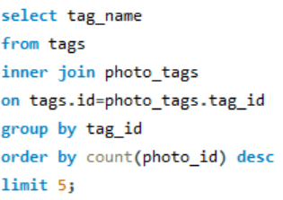
Project Insights
A) Marketing Analysis:
4. Hashtag Research: Top five most commonly used hashtags
Hashtags
smile
beach
party
fun
concert
Query:

Slide 9
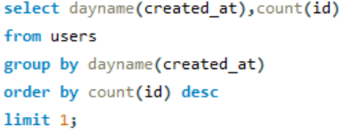
Project Insights
A) Marketing Analysis:
5. Ad Campaign Launch: Most of the users registered
on Instagram on Thursday, so it would be the best day
for the Ad Campaign as user engagement would be
more on Thursdays.
Query:

Slide 10

Project Insights
B) Investor Metrics:
1. User Engagement: By dividing total count of photos
in ‘photos’ table by total count of distinct user_id in
photos table who posted atleast one photo, we get
Average post per user i.e. 3
Query:

Slide 11
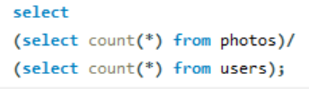
Project Insights
B) Investor Metrics:
1. User Engagement:
Total count of photos/Total count of users= 2.57
we can estimate the user engagement by average number of photos users are posting.
Query:

Slide 12
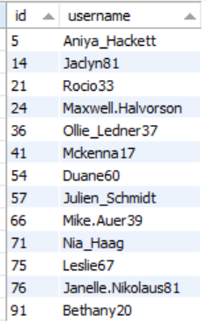
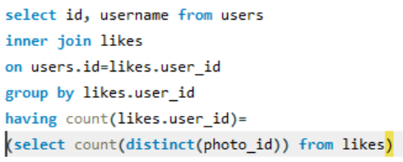
Project Insights
B) Investor Metrics:
2. Bots & Fake Accounts: users (potential bots) who have liked every single photo on the site
Query:

Slide 13
Result
The insights derived from this analysis can be used by various teams within the business. For example, the marketing team might use these insights to launch a new campaign, the product team might use them to decide on new features to build, and the development team might use them to improve the overall user experience.

